Slide 1

Non-Photorealistic rendering
Universidade do Minho
Escola de Engenharia
Mestrado Integrado em Engenharia Informática
Visualização e Iluminação l
A78824 Mariana Lino Costa
A76387 André Ramalho
A64282 Paulo Alves

Slide 2
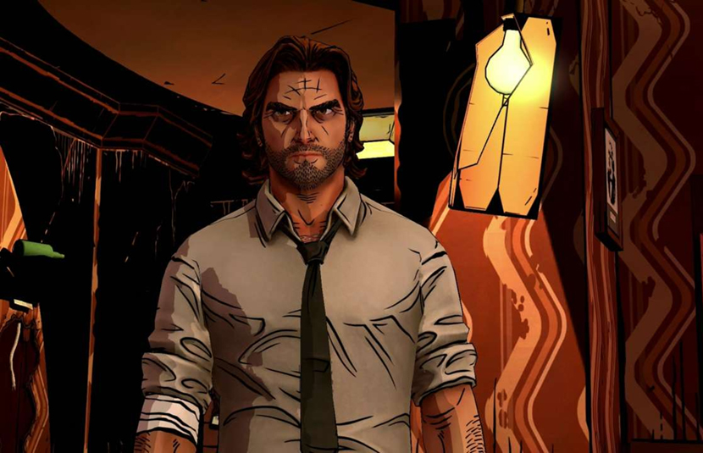
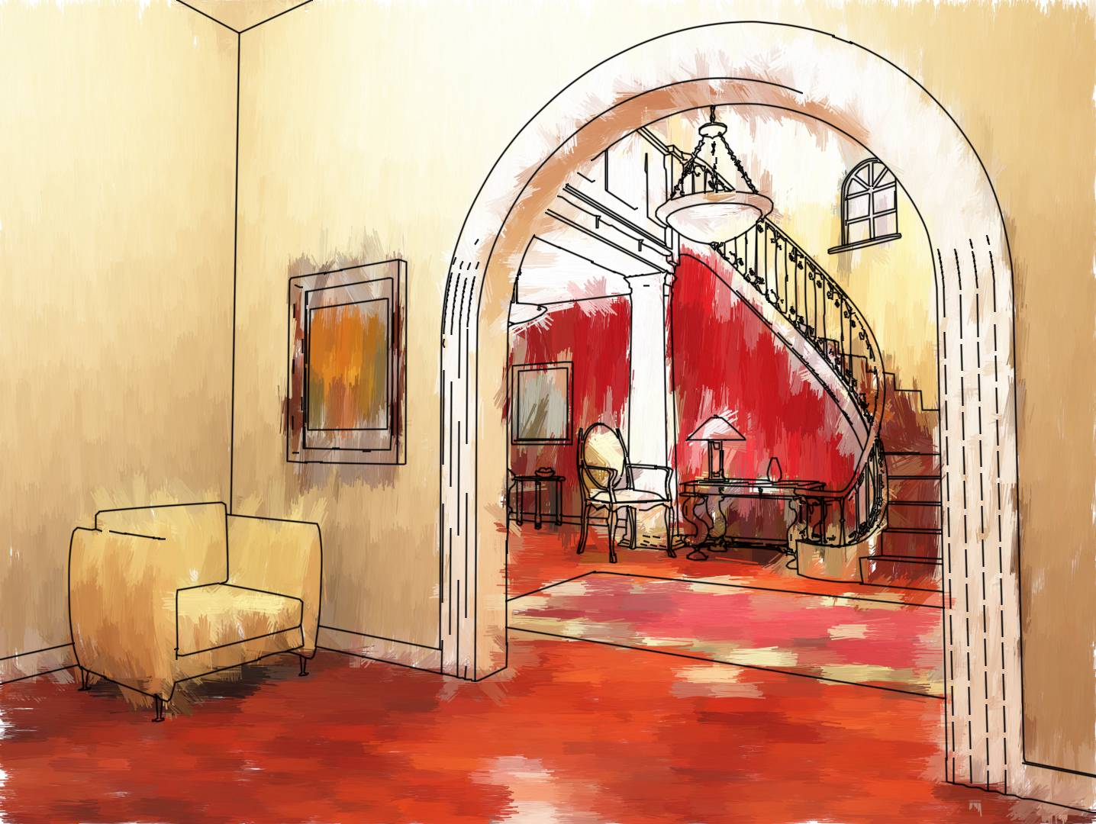
Non-Photorealistic rendering

Slide 3
Non-Photorealistic rendering TYPES

Slide 4
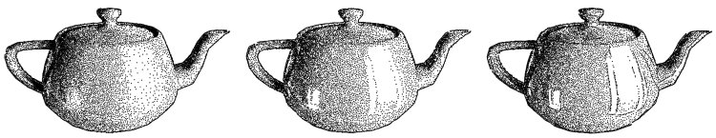
Pen and ink illustrations

Slide 5
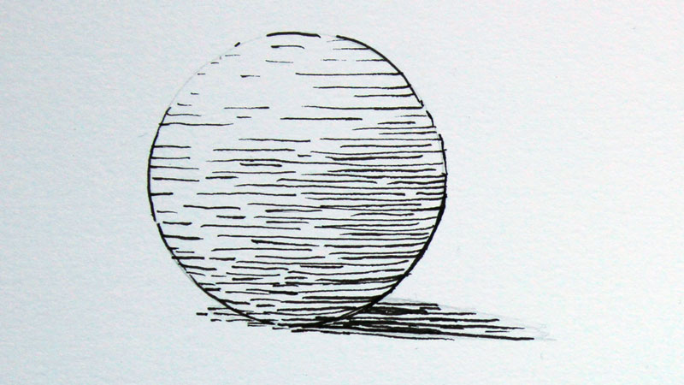
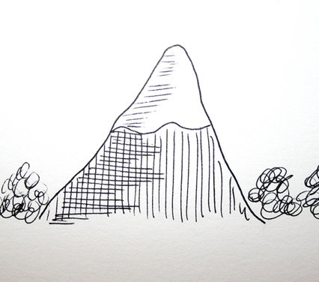
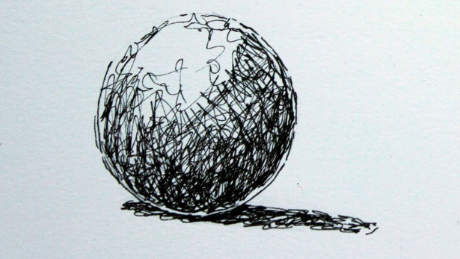
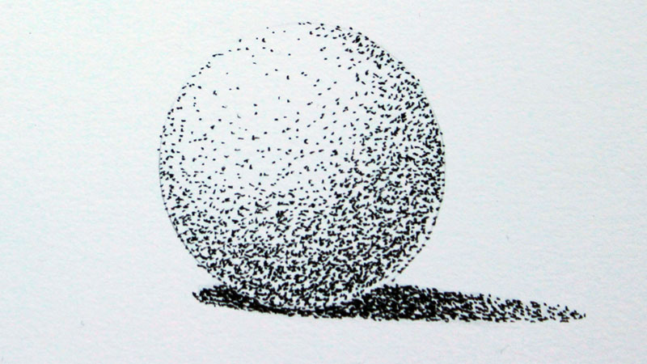
Hatching
Cross- Hatching
Random lines
Spippling

Slide 6
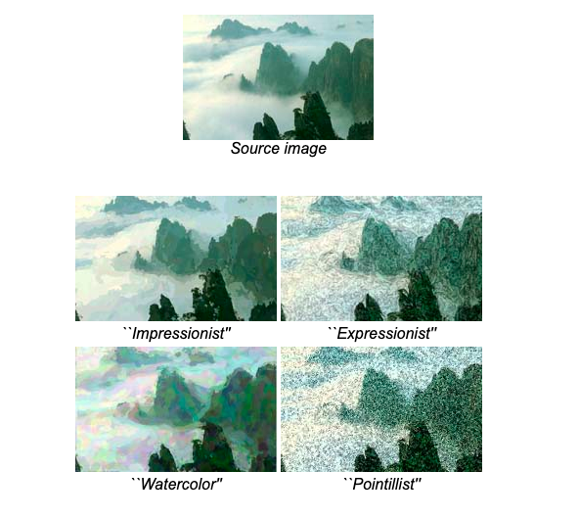
Painterly Rendering
Notes:
replicam estilos com aspeto de pintura

Slide 7
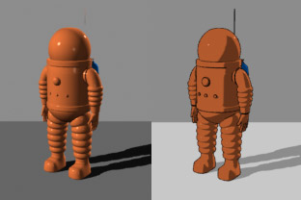
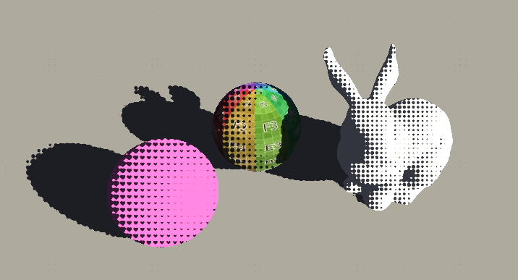
Cartoon rendering
Notes:
usam tecnicas para obter efeitos semelhantes a deseho animado

Slide 8
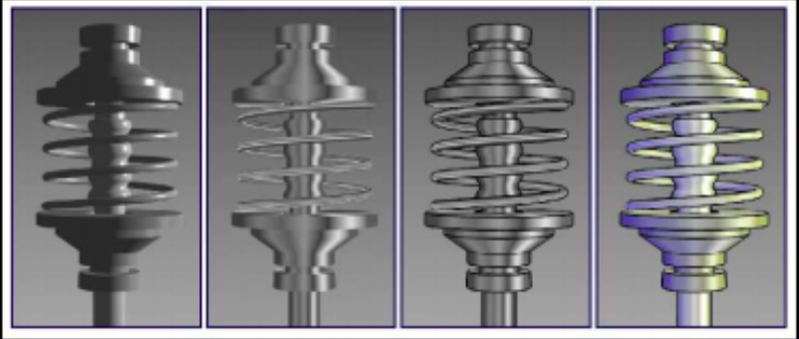
Technical illustrations

Slide 9
SHADERS IMPLEMENTATION

Slide 10
PEN AND INK ILLUSTRATIONS
HATCHING
CROSS-HATCHING WITH TEXTURES
CROSS-HATCHING

Slide 11
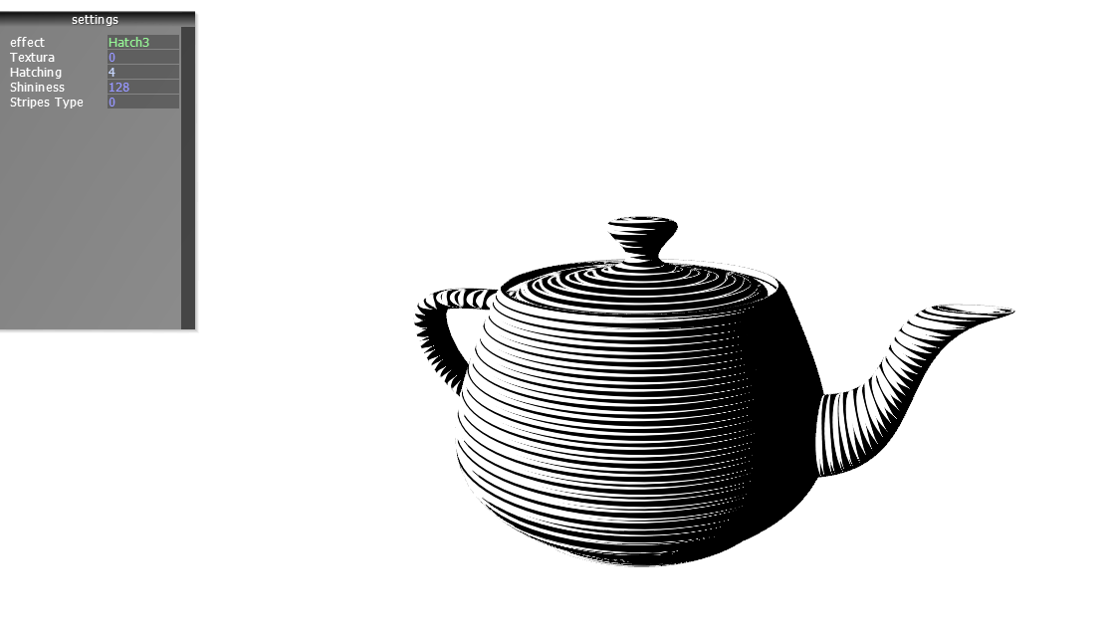
HATCHING

Slide 12
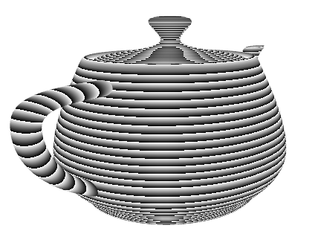
HATCHING

Slide 13
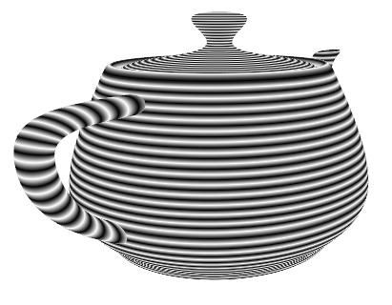
HATCHING

Slide 14
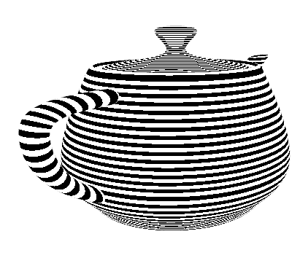
HATCHING

Slide 15
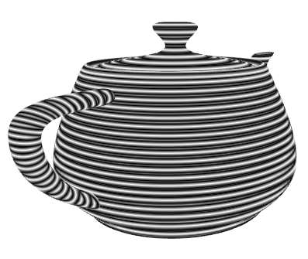
HATCHING

Slide 16
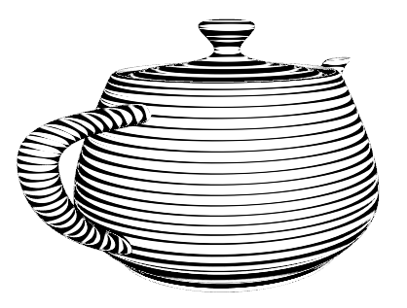
HATCHING

Slide 17
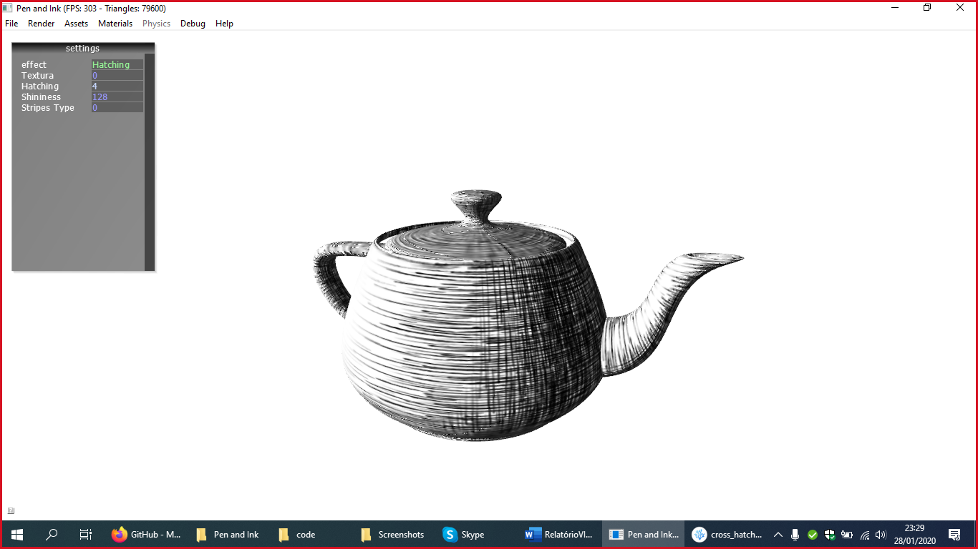
Cross hatching WITH TEXTURES

Slide 18
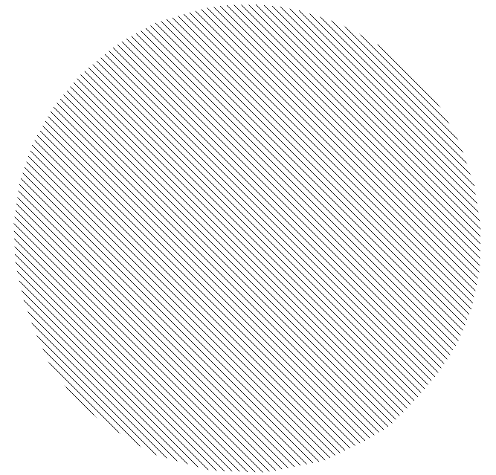
Cross-hatching
Intensity <1

Slide 19
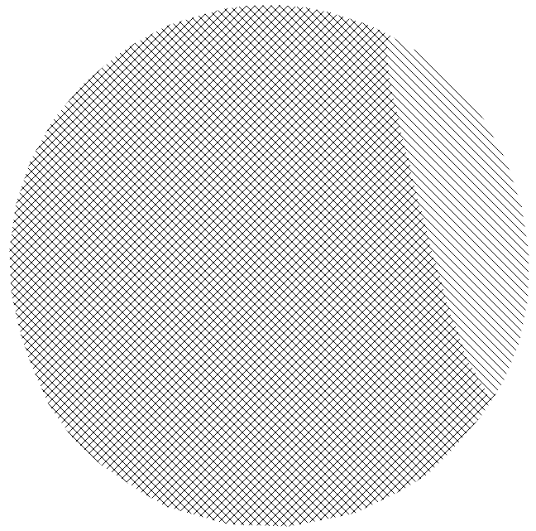
Cross-hatching
Intensity < 0.75

Slide 20
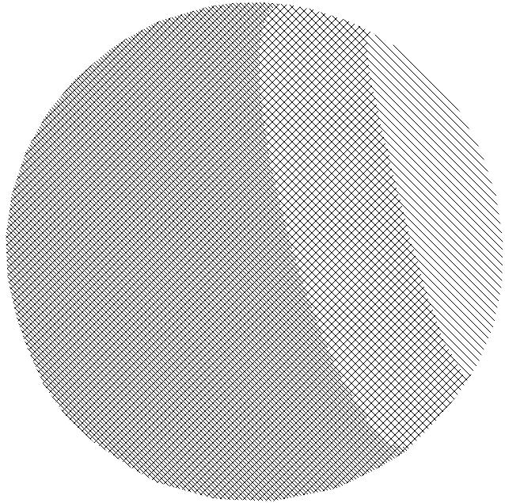
Cross-hatching
Intensity < 0.5

Slide 21
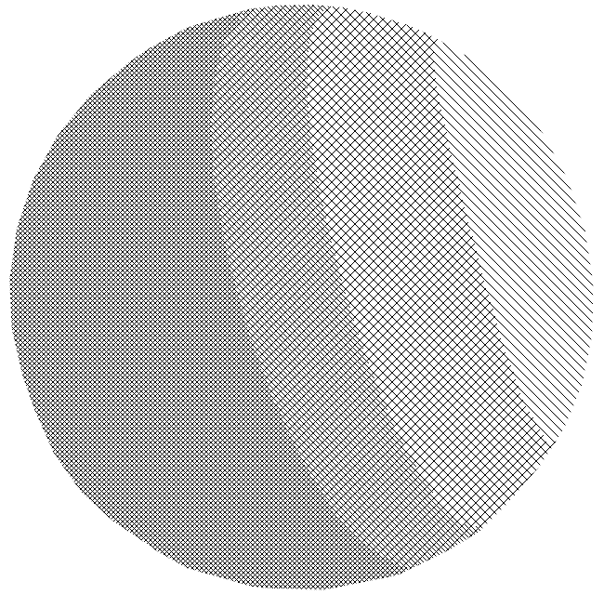
Cross-hatching
Intensity < 0.25

Slide 22
PAINTERLY RENDERING SHADERS
OIL PAINTING EFFECT SHADER

Slide 23
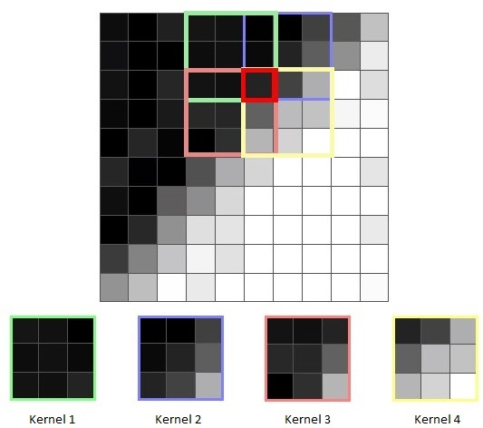
OIL PAINTING SHADER
Compute mean and variance for each region
Choose a kernel with the lowest variance
Pixel color takes the mean of that kernel
Huge cost ( > kernel size)

Slide 24
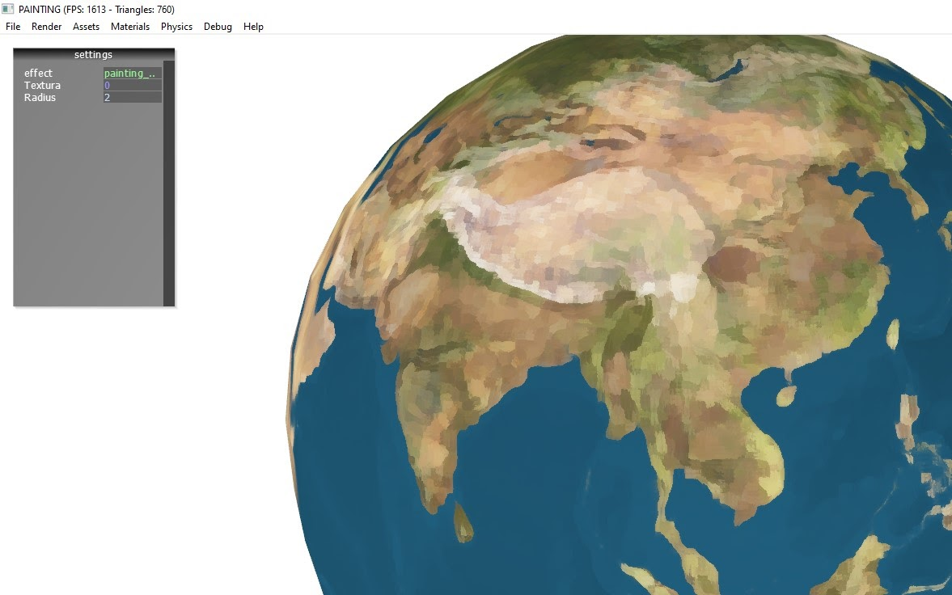

Slide 25
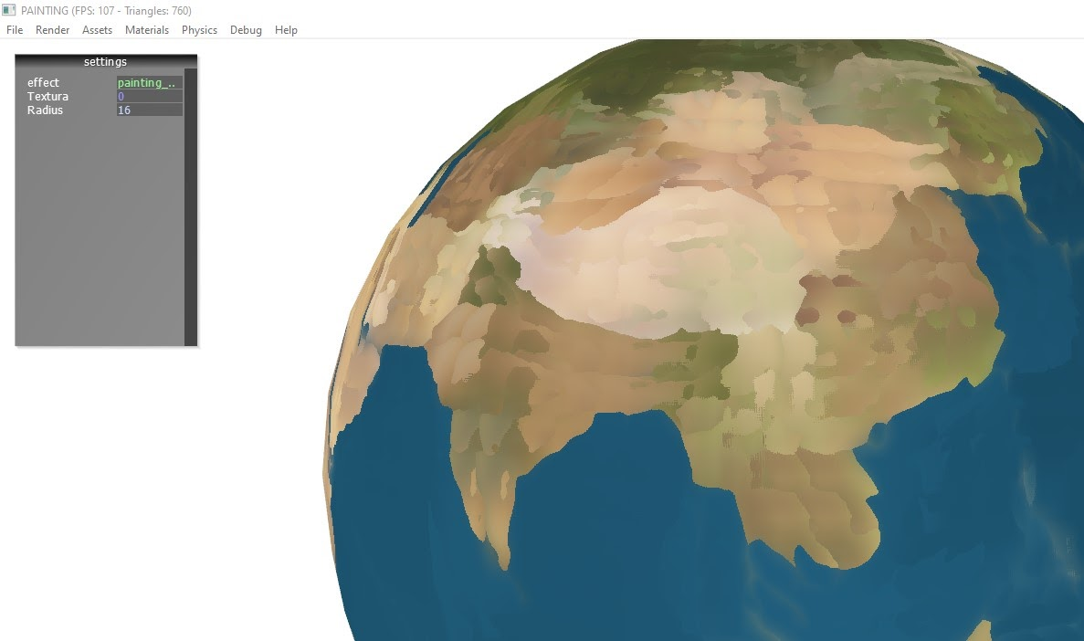

Slide 26
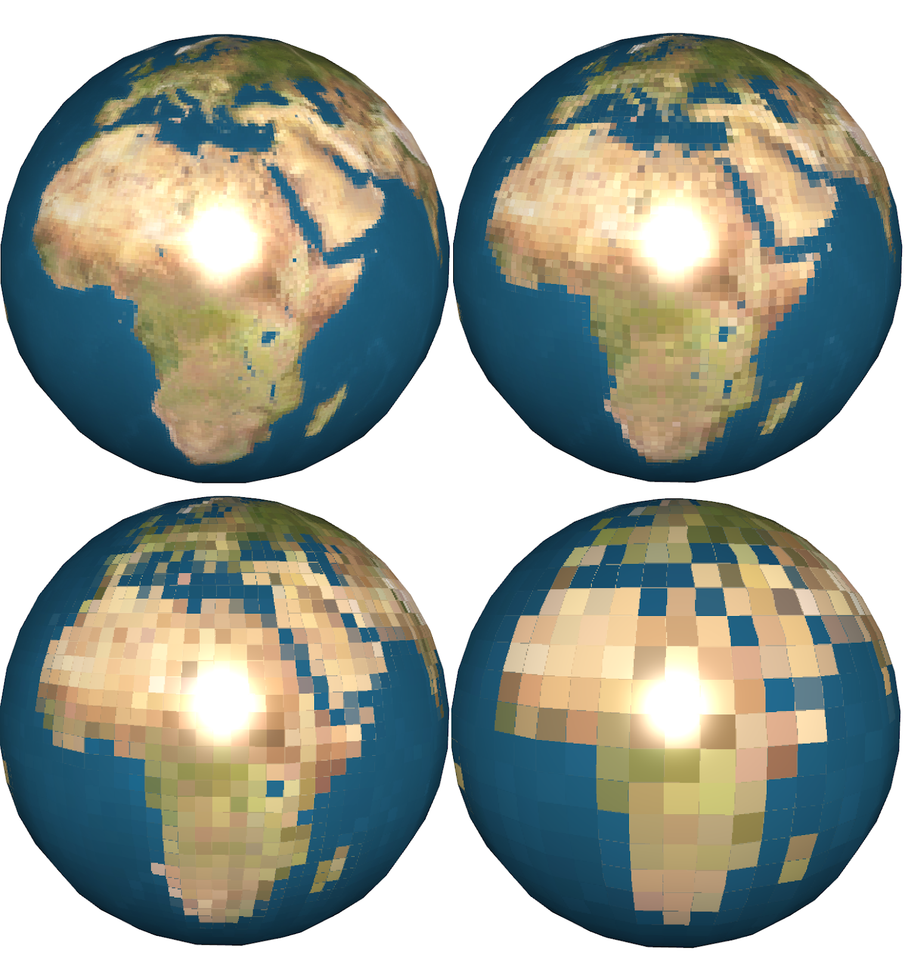
PIXELATED
Choose a size ‘pixel_size’
Image is divided into squares with that size
Every pixel inside each squad takes the same color(lower left)
Bigger squares means less resolution and a more ‘pixelated’ image

Slide 27
CARTOON SHADERS
TOON SHADER
TOON SHADER 2
TOONIFY SHADER
SILHOUETTE SHADER
HALFTONE/DOT SHADER
HALFTONE/DOT SHADER 2D

Slide 28
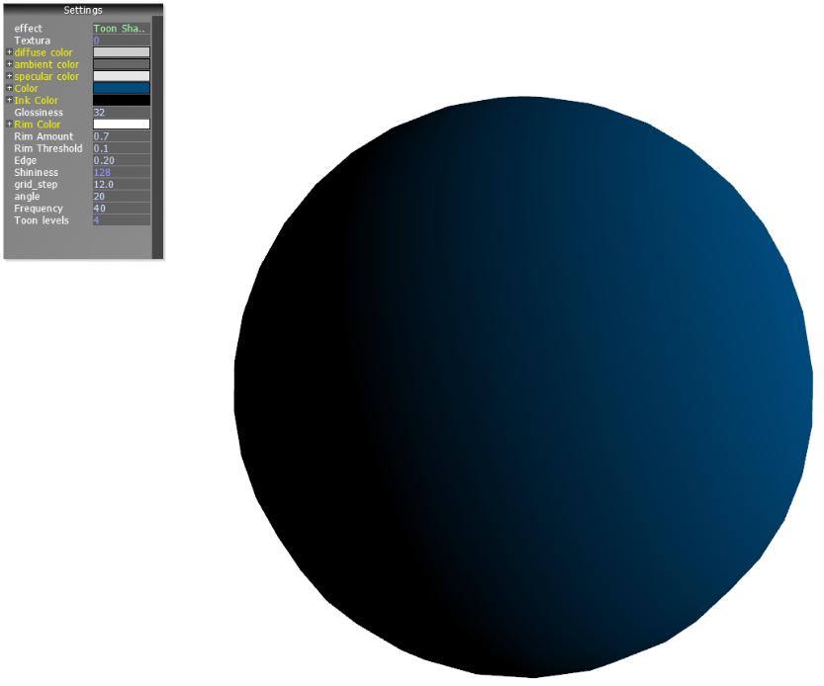
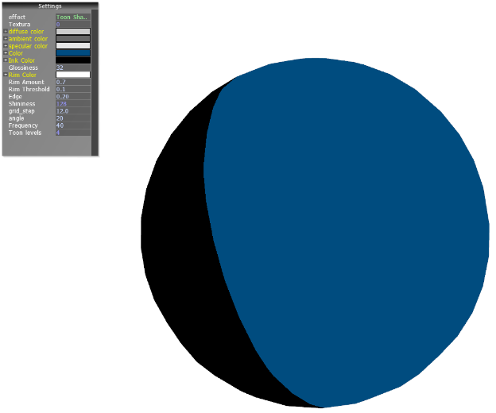
TOON SHADER
Notes:
1. luz direcional atraves produto escalar

Slide 29
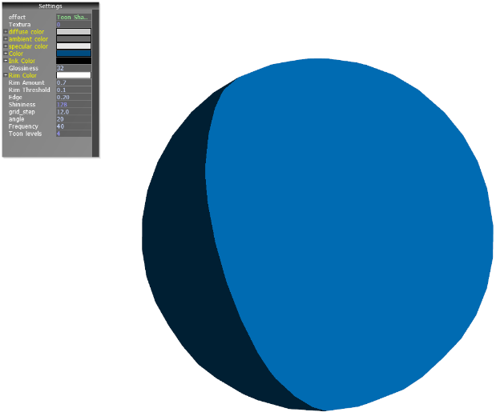
TOON SHADER
Notes:
Luz ambiente

Slide 30




TOON SHADER

Slide 31


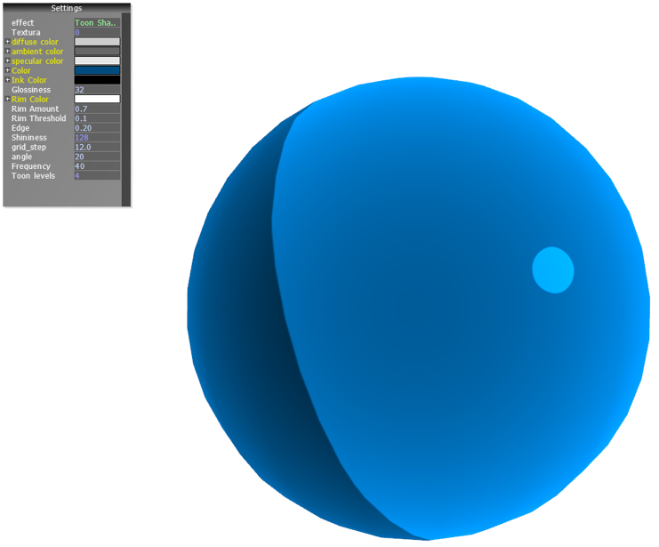
TOON SHADER
Notes:
1. Implementou-se a reflexão especular: depende da direção da vista
e basicamente faz se o produto escalar da normal e o meio vetor ( vetor entre direção da vista e fonte de luz)
2. Suavizou-se o reflexo
3. Iluminação da bora: inverteu-se o produtor escalar da direção normal com a direção da vista

Slide 32


TOON SHADER

Slide 33
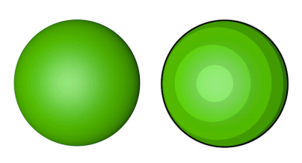
TOON SHADER 2
Smooth color gradient caused by realistic lightning(We don't want that)
Cartoons are flat!!
Choose the amount of shades and calculate light intensity
More intensity = brighter shade

Slide 34
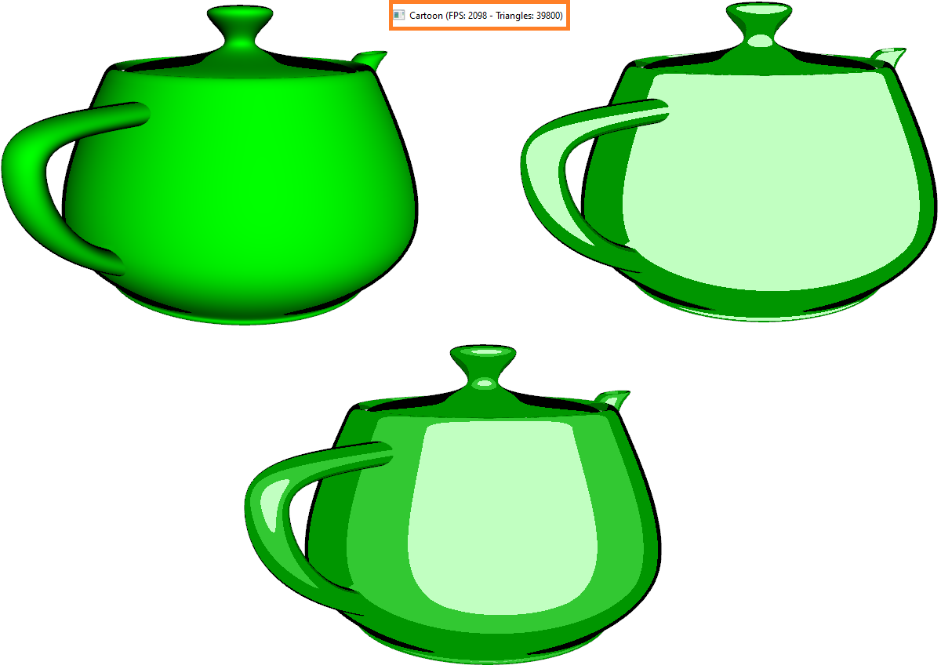

Slide 35
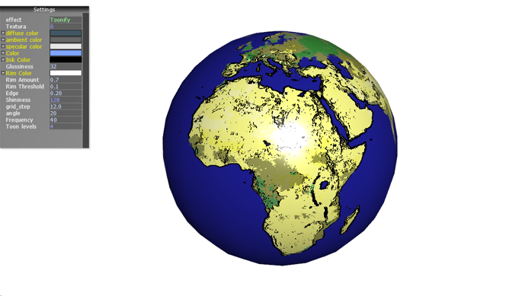
TOONIFY

Slide 36
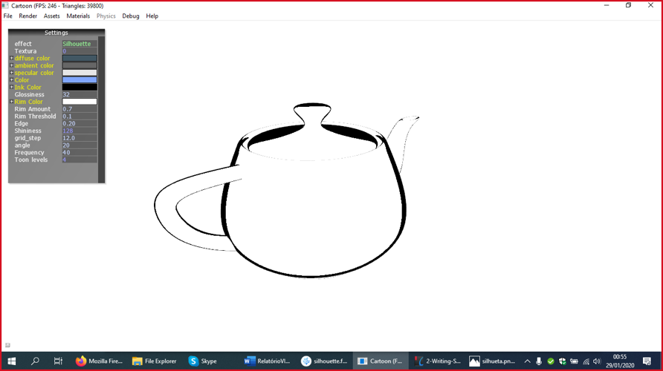
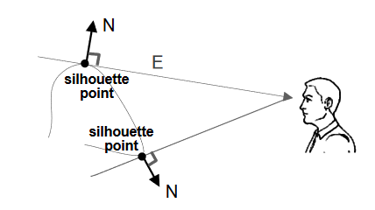
SILHOUETTE SHADER

Slide 37
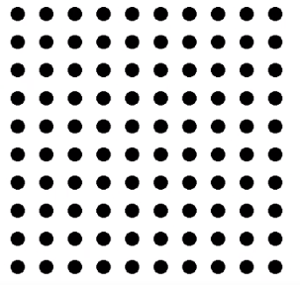
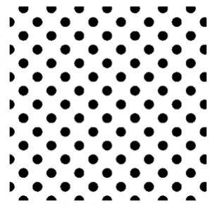
Halftone/Dot shader
Calculate the light diffuse factor;
Rotate the grid;
Calculate the surface color with the circles function

Slide 38
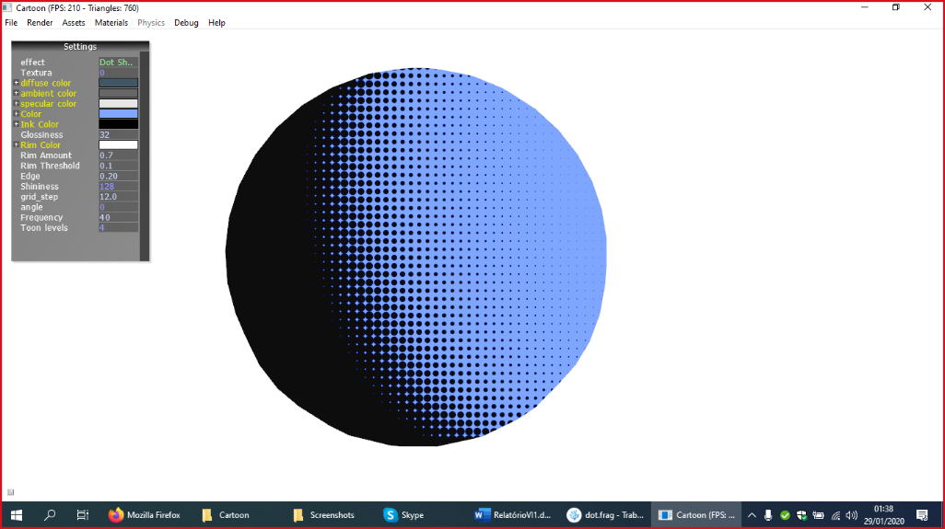

Slide 39
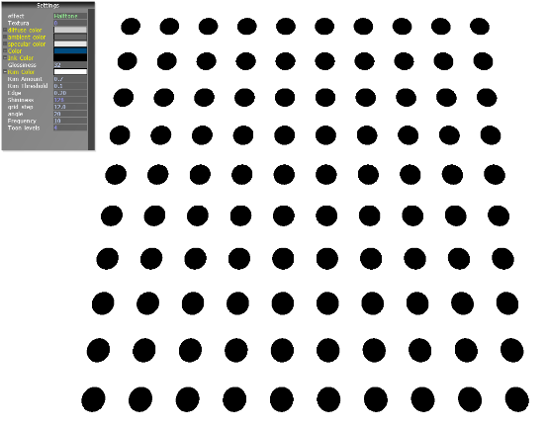
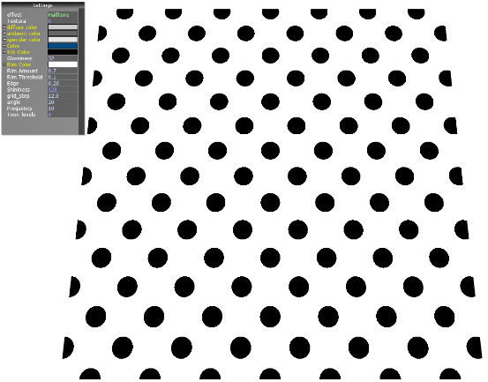
HALFTONE/DOT SHADER 2D

Slide 40

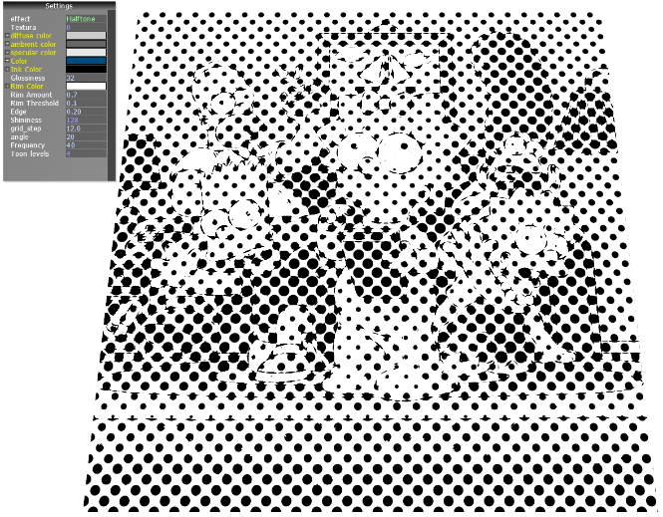
HALFTONE/DOT SHADER 2D

Slide 41

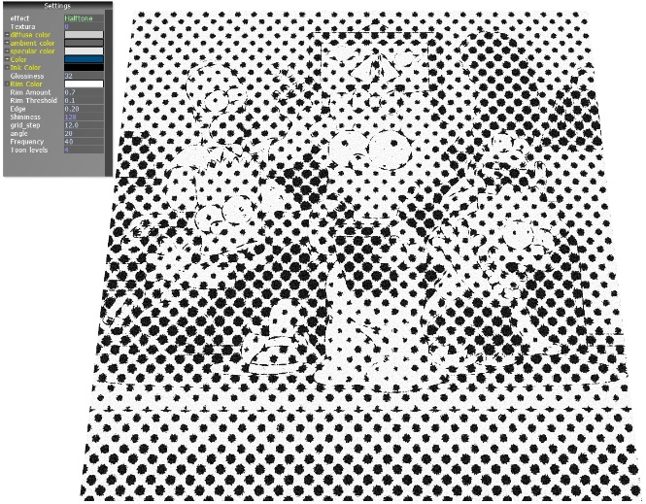

Slide 42
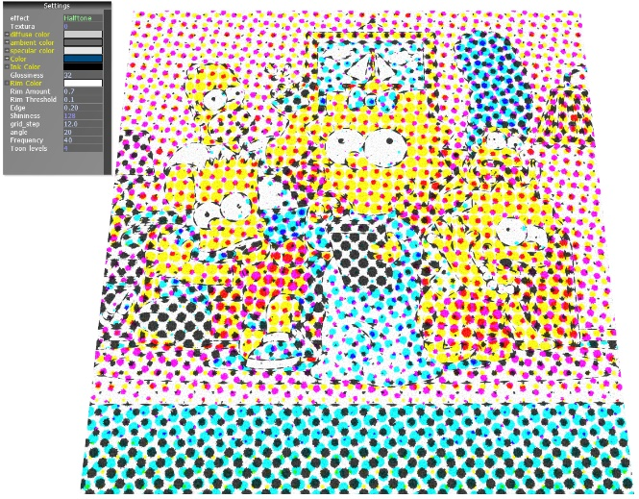
HALFTONE/DOT SHADER 2D

Slide 43
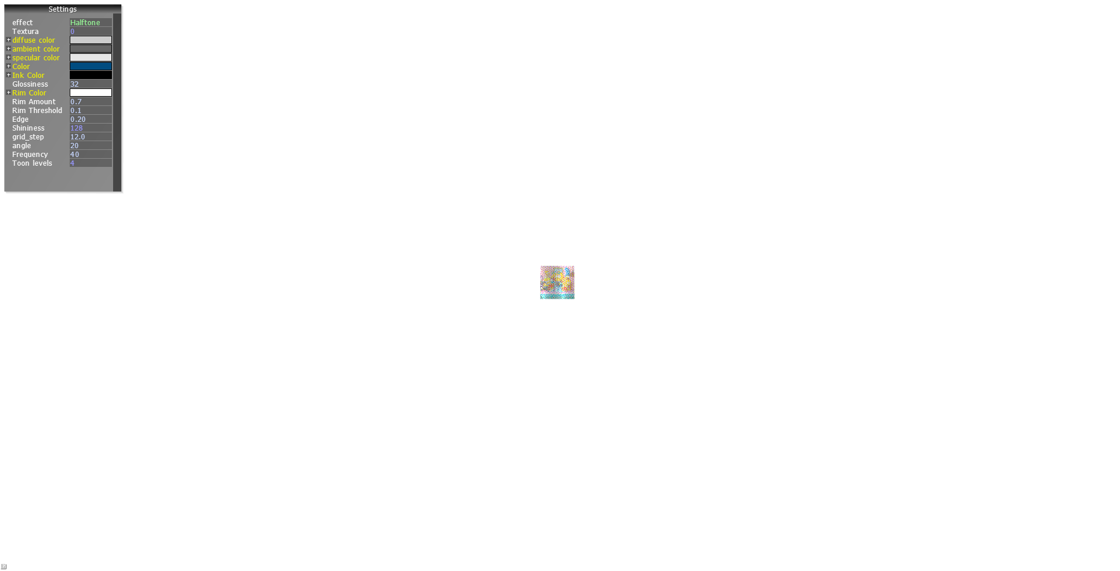


Slide 44
TECHNICAL ILLUSTRATION
GOOSH SHADER

Slide 45
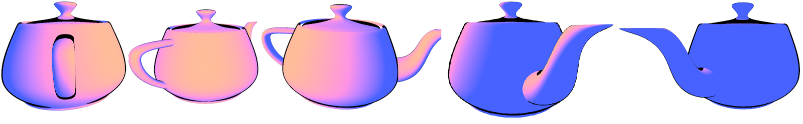
Goosh shader
Choose two color apart from the original
Warm color(red,yellow), Cold color(violet,blue)
Shading using a combination of the three colors
Higher light intensity means warmer colors and vice-versa

Slide 46
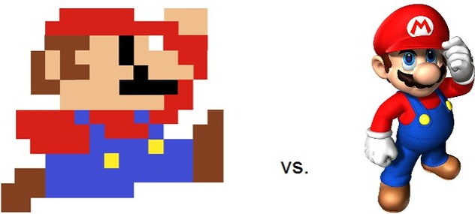
Realism vs Non-Realism
Reality is not discrete
Reality costs too much while abstraction is bound by imagination

